Slide 1
Unit - v
5.2 Technological change and imperfect competition market
5.3 Market failures & externalities

Slide 2
5.2 introduction
The great strength of the market economy has been its ability to increase productivity, raise living standards, and innovate.
Yet the basic competitive model (perfect competition) assumed the state of technology as given.

Slide 3
We must go beyond the basic competitive model by recognizing two important factors.
First, industries in which technological change is important are almost always imperfectly competitive.
Second, the basic competitive model assumed that individuals and firms receive all the benefits and pay all the costs of their actions, yet the basic research that leads to technological change can produce important positive externalities.

Slide 4
example
Tim Berners-Lee, Robert Cailliau, and their colleagues at the European particle physics center (CERN) in Geneva, Switzerland, invented the World Wide Web and hypertext markup language, or HTML, in 1990, and since then programmers from around the world have been able to use and benefit from their ideas.
The creation of these new products conferred benefits well beyond what consumers had to pay for them.

Slide 5
Links between technological change and imperfect competition
In modern industrialized economies, competition often takes the form of trying to develop both new products and new ways of making existing products.
In industries in which technological change is important, such as the computer and drug industries, firms devote considerable resources to R & D - research (discovering new ideas, products, and processes) and development (perfecting, for instance, a new product to the point at which it can be brought to the market).
Technological change and imperfect competition are inevitably linked for four major reasons.

Slide 6
Technological change and imperfect competition link - four major reasons
First, to make R & D expenditures pay, and therefore stimulate innovation, inventions are protected from competition by patents (which are specifically designed for that purpose).

Slide 7
ECONOMIC EFFECT OF PATENTS
Here, an innovation has reduced the marginal cost of production
from c0 to c1. Before the innovation, the equilibrium price is p0, which equals c0. However, an innovator with a patent will drop the price to p1, just below p0, and sell the quantity Q1. Total profits are the shaded area ABCD. When the patent expires, competitors re-enter the market; price falls to p2, which equals c1; and profits drop to zero.

Slide 8
Second, industries in which technological change is important typically have high fixed costs - Costs that do not change as output increases and thus their average costs decrease over a wide range of output, another characteristic that limits competition.

Slide 9
COSTS OF RESEARCH AND DEVELOPMENT
R & D costs are fixed costs - they do not vary with the scale of production. In industries that are R & D intensive, average costs will be declining over a wide range of outputs. Firms with low levels of output (Q1) have higher average costs than those with higher output (Q2).

Slide 10
Third, industries characterized by rapid technological change are also industries in which the benefits of increasing experience in a new production technique can lead to rapidly decreasing costs.
Finally, because banks are generally unwilling to lend funds to finance R & D, raising capital is difficult for new and small firms.
All these factors make entry difficult, and reduce competition of the sort assumed by the basic competitive model.

Slide 11
HOW COMPETITION AFFECTS TECHNOLOGICAL CHANGE
Competition spurs R & D | Competition impedes R & D
A new innovation enables firms to enjoy profits (profits are driven to zero in standard markets). | Competitors may imitate, thus eroding returns from innovation.
Unless firms innovate, they will not survive | Competition erodes the profits required to finance R & D.

Slide 12
R & D spurs competition | R & D impedes competition:
R & D provides an alternative to prices as a way for firms to compete; it is one of the most important arenas for competition in modern economies. | Patents give a single firm a protected position for a number of years. The fixed costs of R & D give large firms an advantage; thus industries in which R & D is important may have few firms. Learning by doing gives a decided advantage to the first entrant into a market. Limited access to capital markets for financing R & D is a disadvantage to new and small firms.

Slide 13
conclusion
Monopolies and oligopolists with entry barriers have incentive to innovate in comparison to perfectly competitive firms
Example - Farmers producing under perfect competition developed none of the innovation that have vastly raised agricultural productivity over the past century
Rather, they were developed by a few oligopolistic firms/manufacturers of farm equipment.

Slide 14
5.3 Labour market
How market determines incomes?

Slide 15
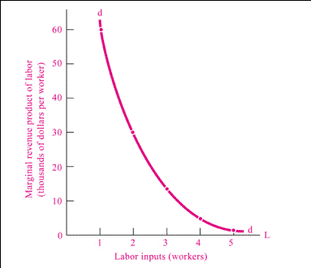
Demand for labour

Slide 16
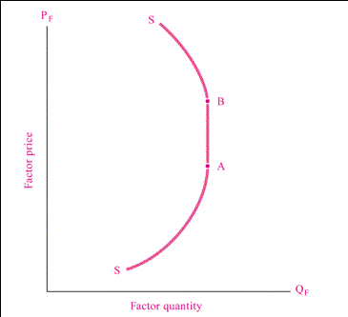
Supply of labour

Slide 17
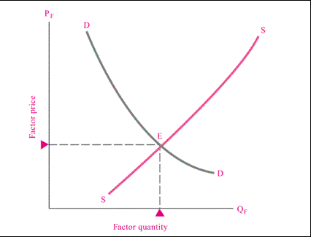

Slide 18
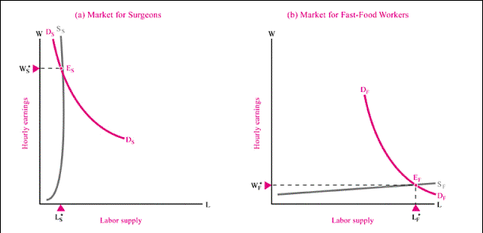
The market for surgeons & fast-food workers

Slide 19
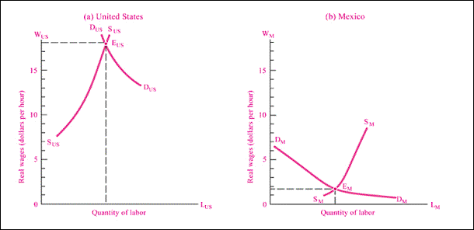
Favorable Resources, Skills, Management, Capital, and Technology Explain High U.S. Wages

Slide 20
Why wage rate differs?
Skills differences of workers
Educational qualifications
Experience
Productivity of labour
Hazardous & dangerous occupations
Bargaining power of laborers
Technology – Athletics, entertainers
Can give single performance that reaches to the whole world via TV/Internet

Slide 21
5.3 market failure

Slide 22
A market failure occurs when the competitive market system:
does not allocate any resources whatsoever to the production of certain goods, or
either under-allocates or over-allocates resources to the production of certain goods.
When private markets fail, government involvement may arise.

Slide 23
Causes of market failure
Monopoly
Imperfect market information – Asymmetric information
Adverse selection
Moral hazard
Public goods –
Non-rivalry in consumption - If I consume more, others do not need to consume less
Non-excludability - You cannot prevent people from consuming the good – Free rider problem
Defence, Light House

Slide 24
Externalities - When the costs of producing or the benefits of consuming spill over to other people.
Negative externalities - Pollution
Positive externalities – Education, Research

